Slide 1

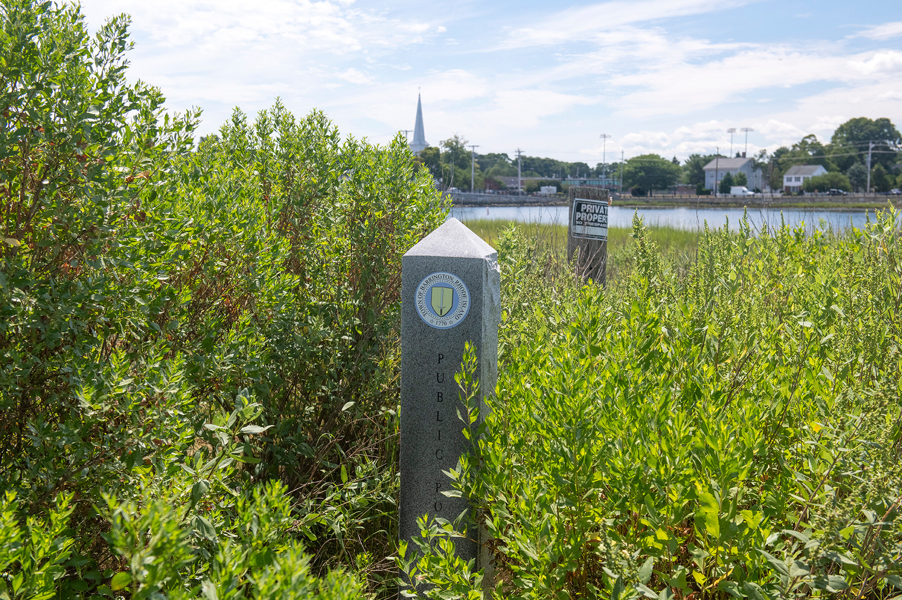
PRESENTED JANUARY 2024
Shoreline Access Needs Assessment: Results
  RI COASTAL RESOURCES MANAGEMENT COUNCIL
  RHODE ISLAND SEA GRANT
  NARRAGANSETT BAY NATIONAL ESTUARINE RESEARCH RESERVE
  IMPACT BY DESIGN
Notes:
The impetus for the NOAA PSM – covid exposed the need for education, improved signage, and a renewed focus on CRMC’s public access program. We made it a priority item in our Section 309 plan, and then applied for and received a competitive grant from NOAA.

Slide 2
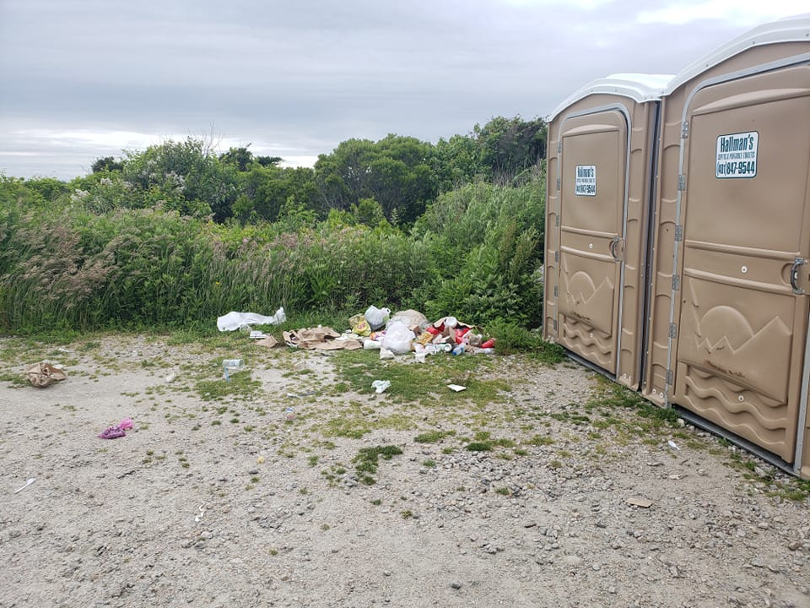
Introduction
Recognizing increasing interest in and conflicts around shoreline access, the Rhode Island Coastal Resources Management Council (CRMC) and Rhode Island Sea Grant (RISG) partnered to develop a shoreline access management plan.
Notes:
But first we needed to really understand what RIers and tourists wanted and needed in terms of shoreline public access.

Slide 3
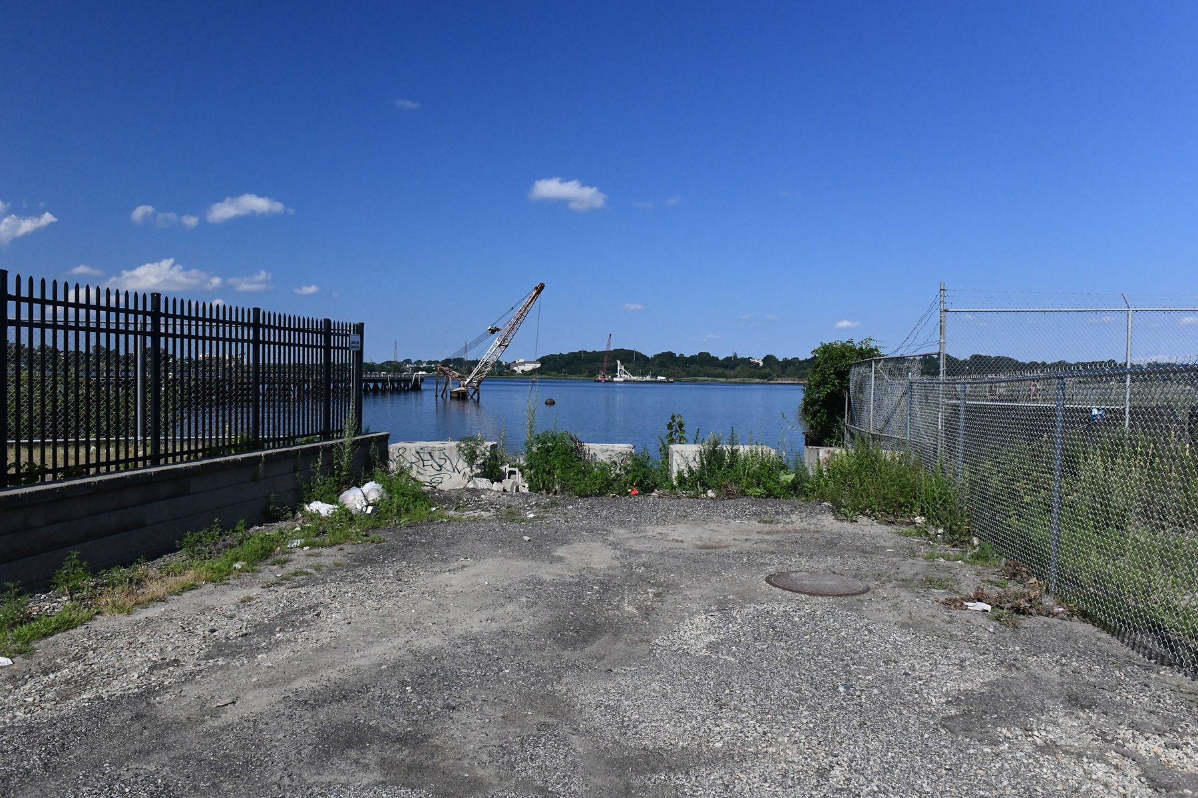
Needs Assessment
We recognized we needed to do a needs assessment rather than rely on our own perceptions of what a Public Shoreline Access Management Plan needed to include.
We brought in NBNERR and Impact by Design, and with NOAA funding, our project “Developing an Equitable and Inclusive Shoreline Access and Education Plan for Every Rhode Islander: Achieving Environmental Justice for All” began the needs assessment process.

Slide 4
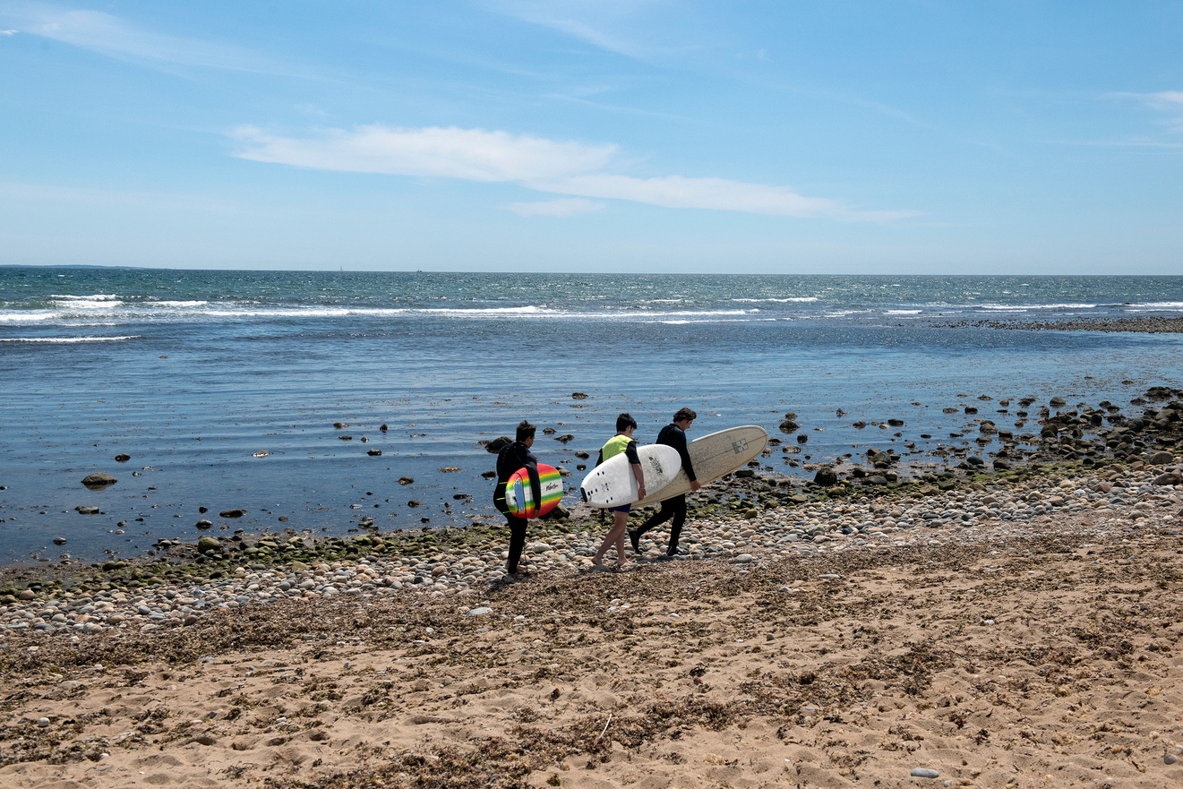
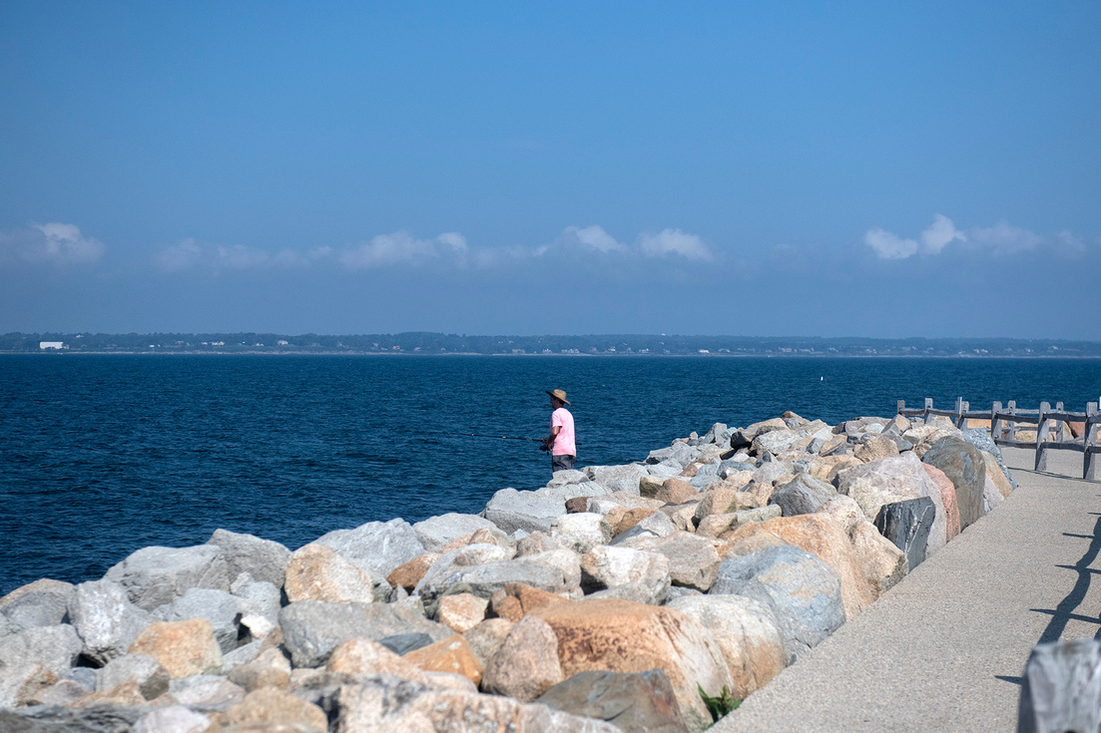
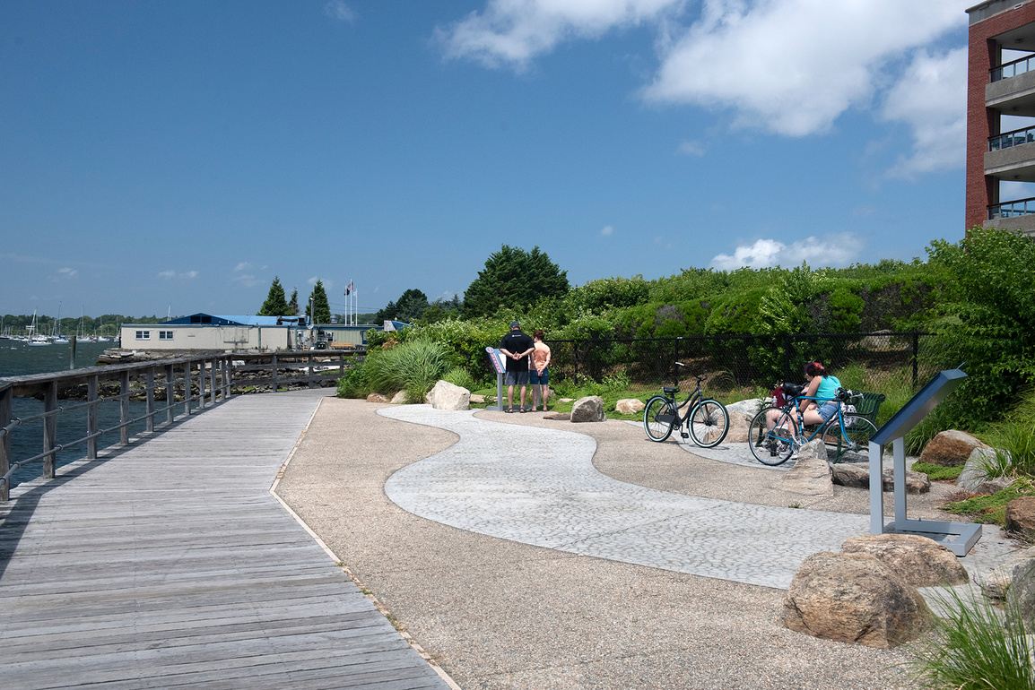
Step 1:
Questions
We wanted to understand how people used the shoreline, where they went and how often, what they wanted to see at ROWs, and what barriers prevented them from using ROWs.
Notes:
We didn't limit our questions to only CRMC-designated rights of way as we realized that we needed to understand the complete picture of shoreline use and access to see if there were gaps that CRMC had a role in filling in. For instance, if people were satisfied with shoreline access, even if it wasn't at CRMC ROWs or other CRMC areas, that would mean CRMC could use resources elsewhere. But if they weren't satisfied, perhaps CRMC ROW designation or other programs that incorporate shoreline access into permitting might help meet their needs.

Slide 5
The Questions
Where do RoW users currently seek out information about RoW access and issues? Where would they prefer to get information?
Where do RoW users go to report a problem, if they do? Do they experience difficulties in reporting issues and receiving support?
Which access points are shoreline users using, and for what activities?
What are people’s perceptions (e.g., quality, quantity, safety, availability, function, etc.) of access points?
What barriers are RoWs users experiencing in accessing RoWs? (e.g., lack of info about RoW use, lack of interest in going, lack of time to go, feeling unsafe/unwelcome)?
How and why do people want to see access to RoWs change (e.g., adding more bike lanes, restrictions, etc.)?
Are people aware that various organizations manage RoW/shoreline access, that they are different, and what these organizations do?
Are RoW users aware of RoW policies and general info about RoW access?
What concerns or negative experiences are people having related to RoWs? Do RoW users actively avoid specific RoWs and if so, why? Who do people believe are responsible for issues at RoWs?
How do people get to RoW access points (e.g., walk, bike, drive, bus)? How far do they travel to access points?
Are people in favor of a “dawn to dusk prohibition”? Why/why not?
Notes:
In this case, “RoW” may include CRMC RoWs, municipal RoWs, and other means of accessing the shore.

Slide 6
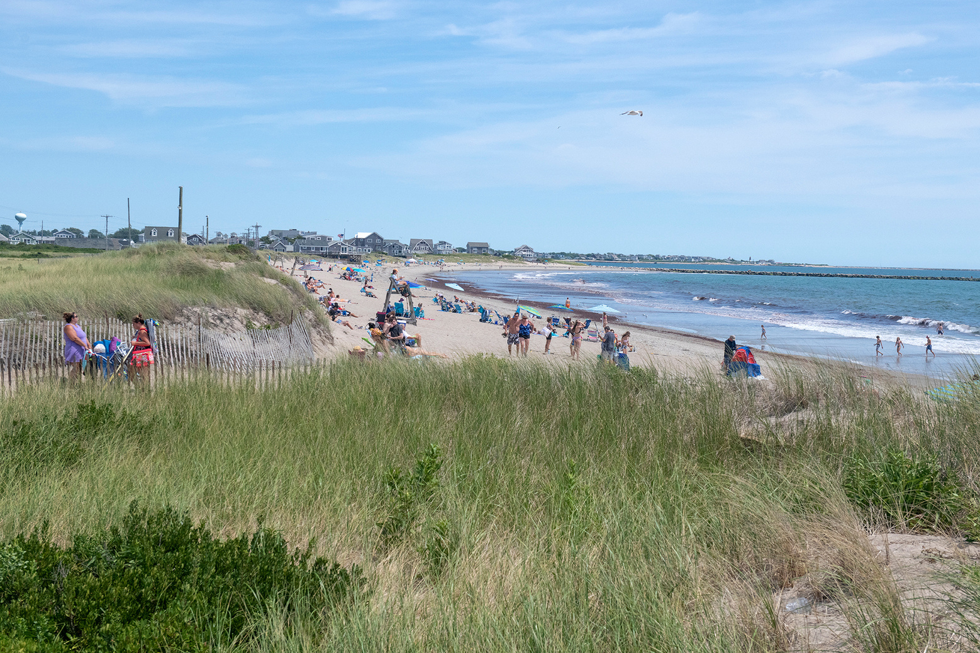
Step 2:
Interviews
Impact by Design interviewed members of different communities/interests (realtor, environmental advocate, community organizer, municipal planner, shoreline access advocate) to ground-truth the questions.
Notes:
Add different survey methods here

Slide 7
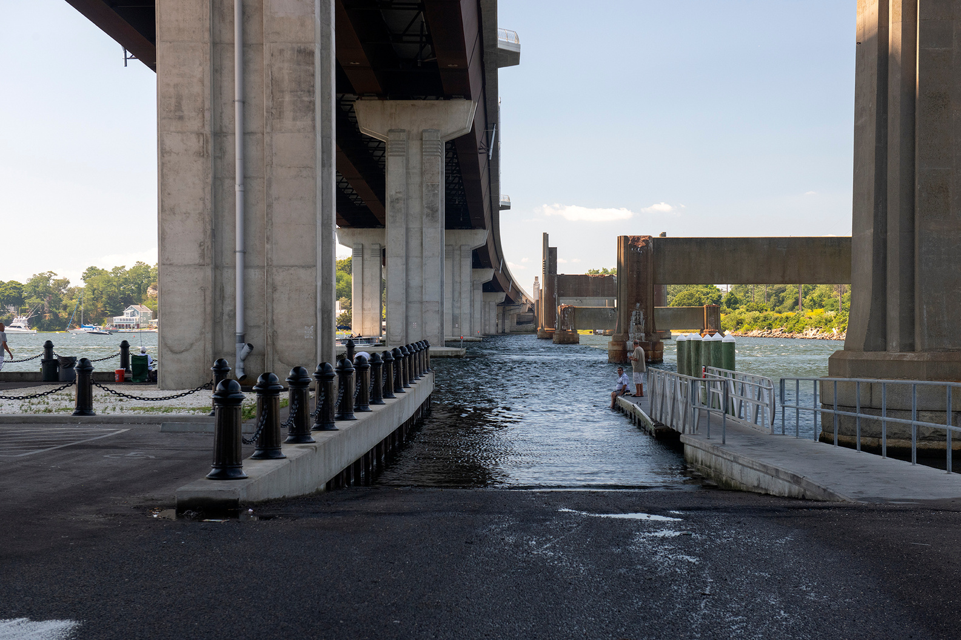
Step 3:
Surveys
We developed a community (Q&A) survey and a map-based (Maptionnaire) survey. People who received the community survey could click through to answer the Maptionnaire questions.
Notes:
The Maptionnaire survey utilized the CRMC-designated ROW map, and people could select any (or several) CRMC ROWs and talk about their use of or issues with these sites. While the community survey included questions about all shoreline uses, the Maptionnaire specifically asked about CRMC ROWs, in part because that was the GIS map we had available to us. But we did want to hone in on CRMC ROWs to some extent.

Slide 8
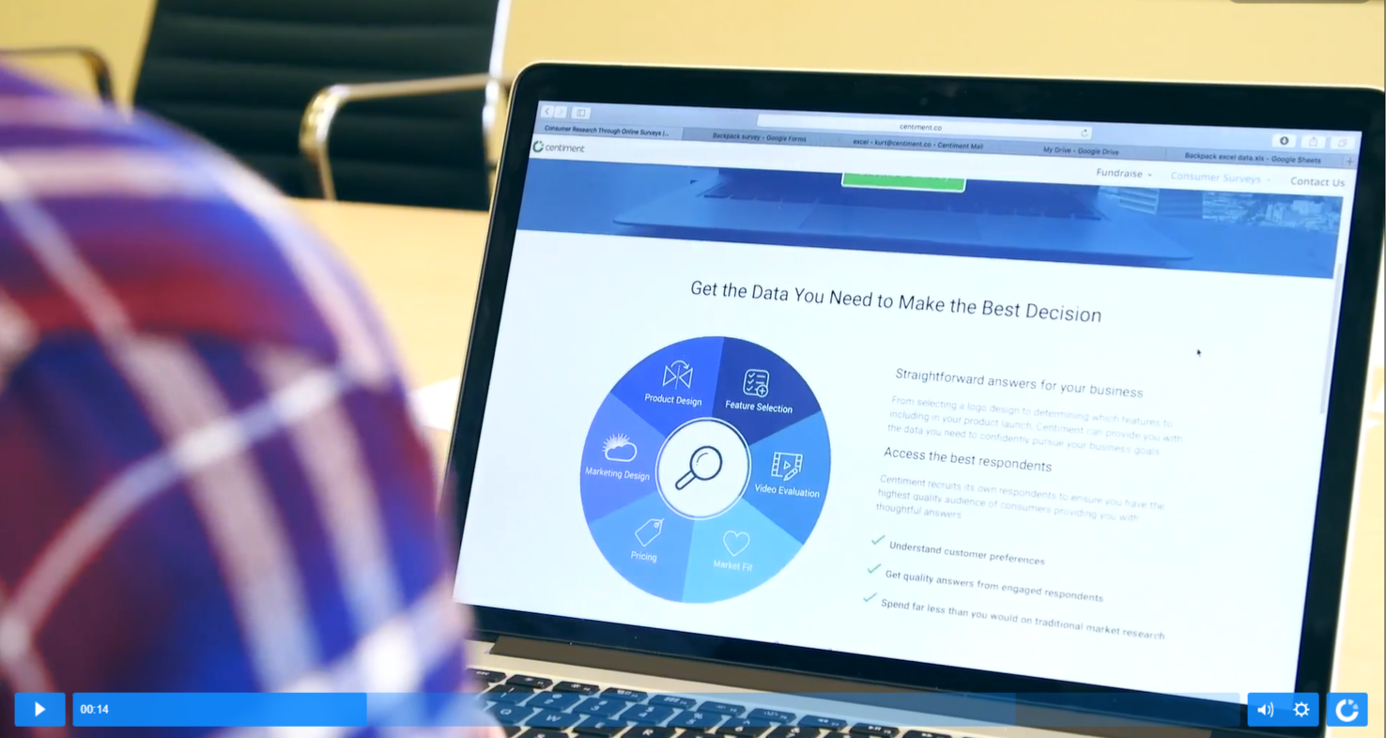
Step 4: Dissemination
Surveys were disseminated through online tools Centiment (RI residents) and Pollfish (tourists), emails to listservs and organizations, social media outreach, and in-person data collection at shoreline rights-of-way in three municipalities around the state.

Slide 9
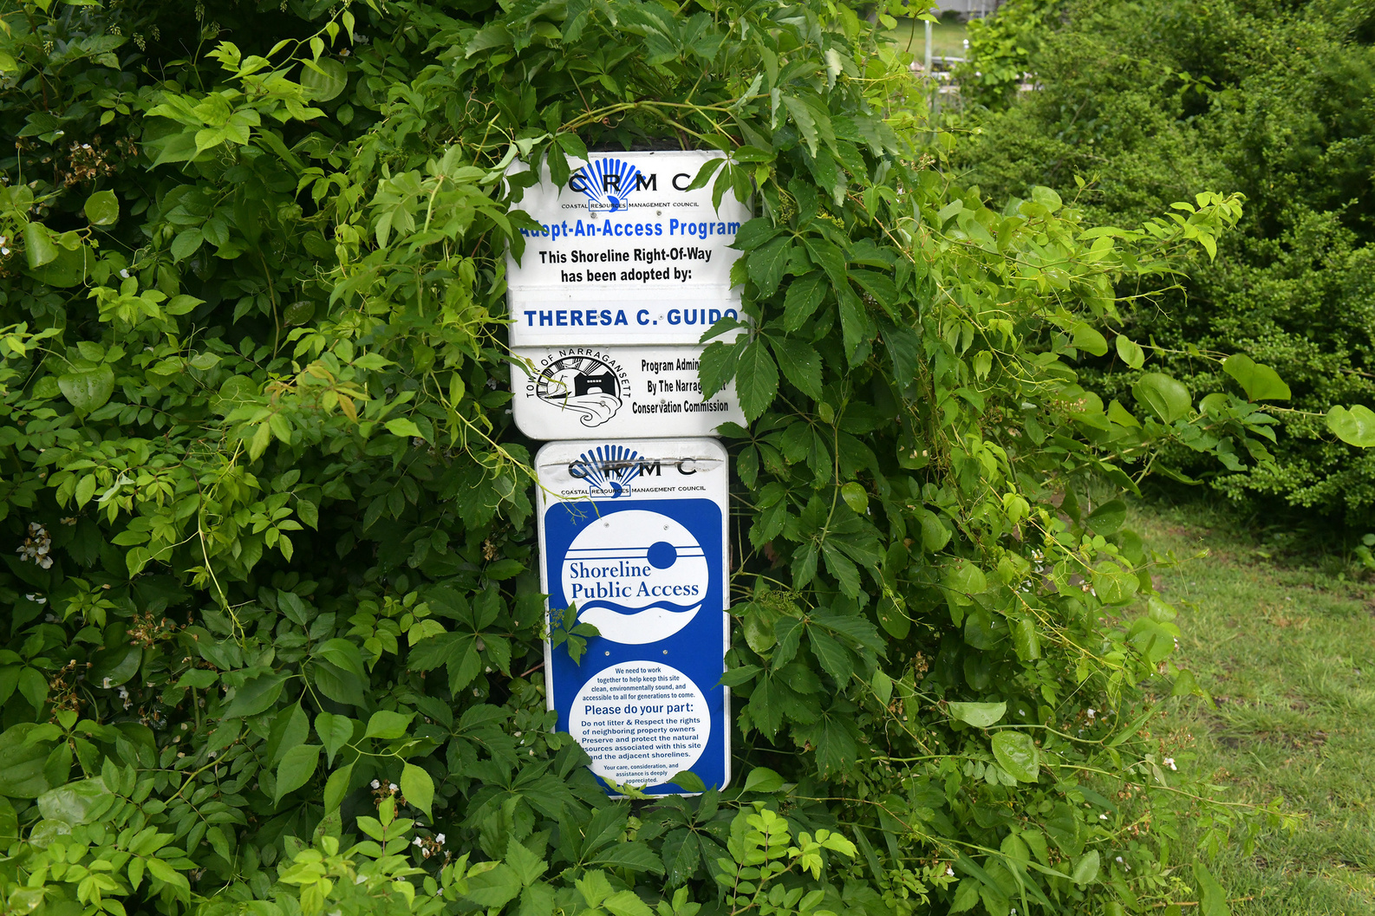
Results
Highlights

Slide 10


SOURCES OF INFO
  RECOMMENDATION
The top 3 sources of information to learn more about general shoreline access and related issues are:
  Word of mouth
  Online searches
  The DEM website
The top 3 ways to make getting information on general shoreline access easier are:
  Dedicated social media OR website where RoW users can get all of their info in one place
  A detailed map, app, or guide
  Identifying parking spot locations + their costs
Notes:
Notably, the CRMC website was not one of the top three sources of information, and people appear not to know about existing map-based guides (both on CRMC’s website and shoreline-ri.com). These resources are listed in the last slide.

Slide 11

  DETERRENTS TO ACCESS
41% of locals said that there are access points they avoid or use less than they used to. The reasons for that include:
  There is no parking near these access points
  They are unsure if they’re allowed to use these access points
  They feel unsafe or unwelcomed there
  Sometimes guards are blocking these access points
  These access points have a lot of litter or are poorly maintained

Slide 12
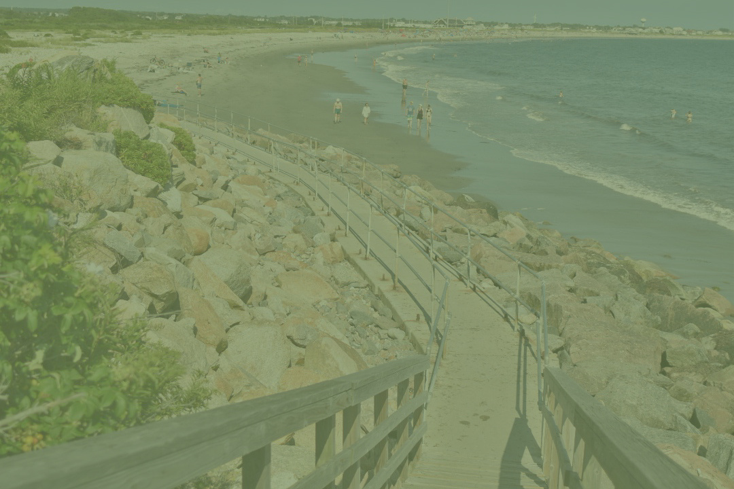
Six Suggestions
To make visiting RoWs easier:
More/better parking and related information
Better signage
Access points that are more accessible to all
An updated map / information on access points
Better maintenance of access points
Stopping locals from blocking public access points

Slide 13
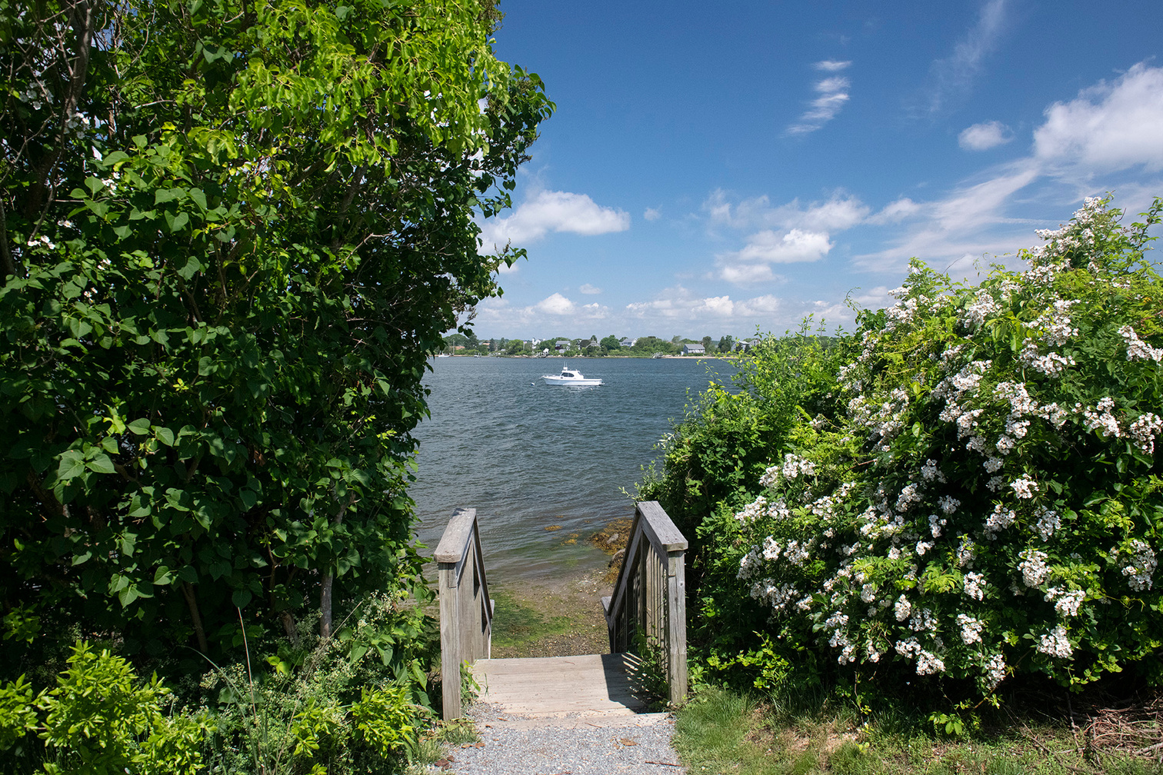
Are There Enough?
When asked if there were enough access points for RoW users to access the shoreline in areas they like to visit, respondents from:
  Washington County were more likely to Strongly Disagree
  Bristol County were more likely to Disagree
  Kent County were more likely to feel Neutral
  Providence County were more likely to Agree
  Newport County were more likely to Strongly Agree
Notes:
While there are fewer ROWS in Providence County than in Washington County, residents of Providence County reported being satisfied with the number of access points in the AREAS THEY LIKED TO VISIT. Most visits to shoreline areas occurred in Washington County (regardless of where people were FROM).

Slide 14
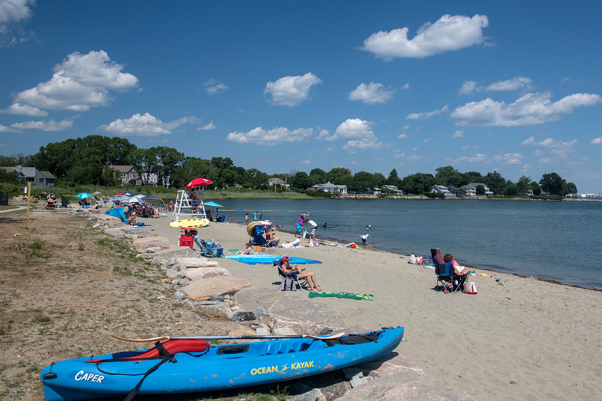
What’s
Next

Slide 15
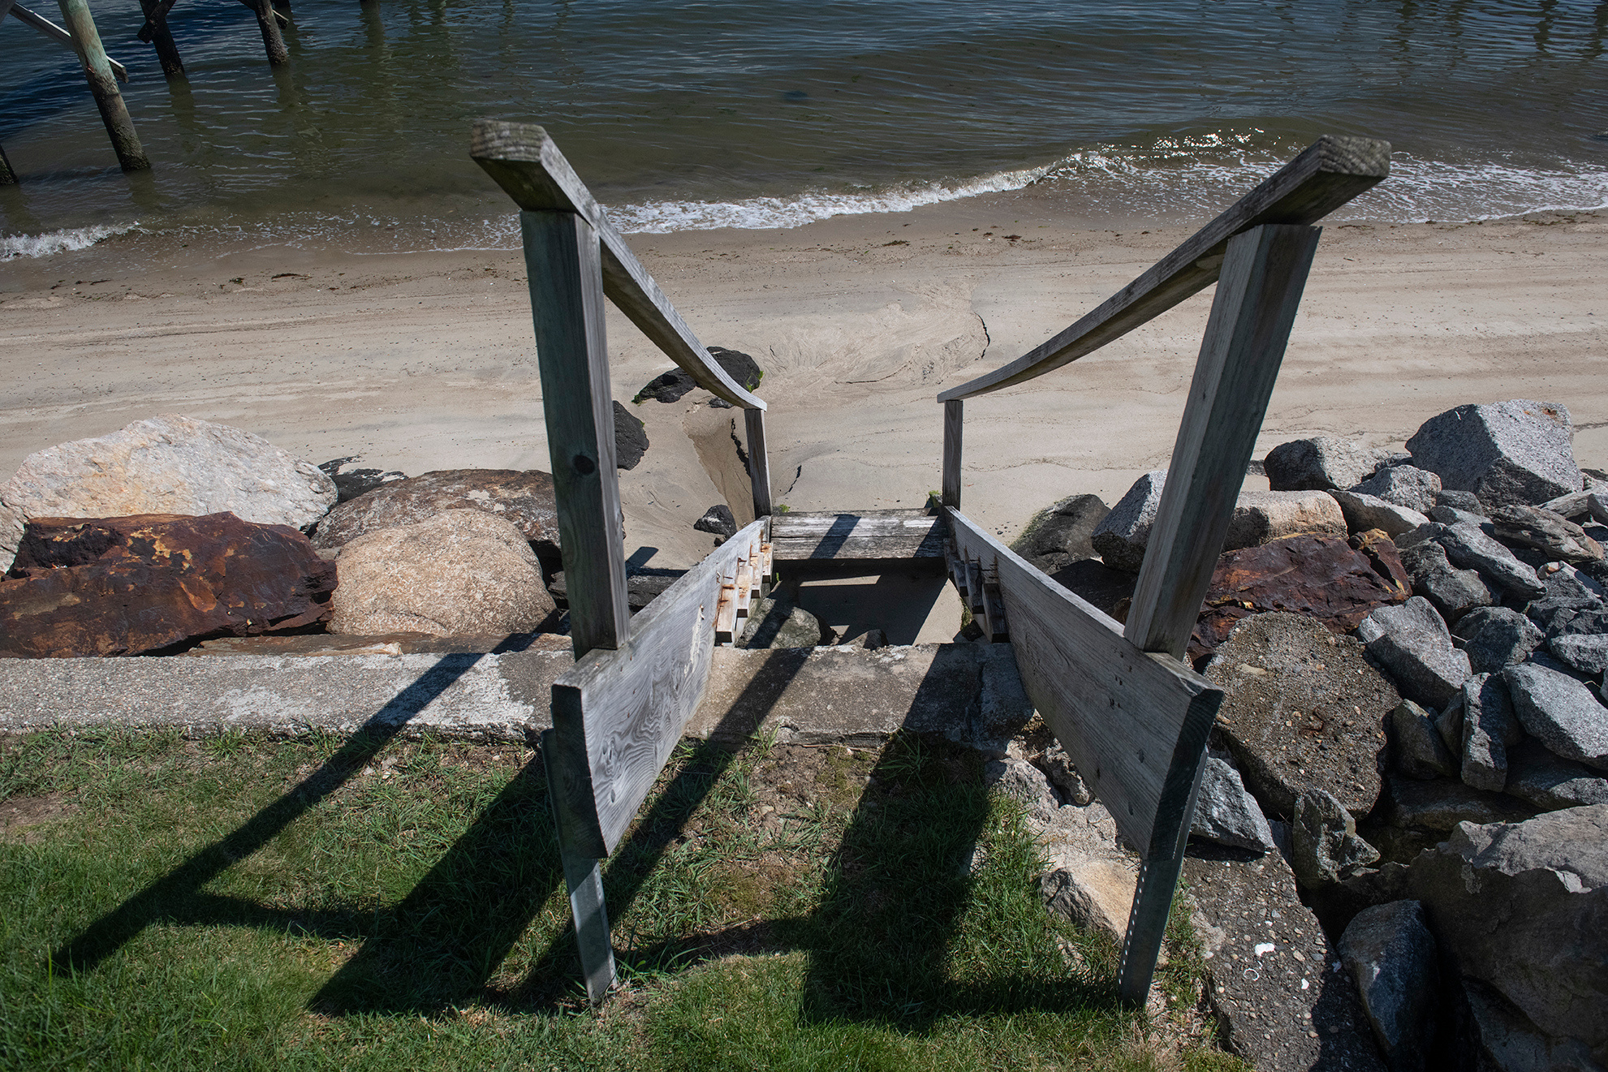
Forming Recommendations
The Community Leader Advisory Group will review needs assessment results, provide feedback, and share experiences and insights that will help identify and prioritize policies and actions that should be included in the Public Shoreline Access Management Plan.
Notes:
The Community Leader Advisory Group includes members of the Warwick Harbor Commission, the Charlestown Climate Resiliency Commission, the town of Narragansett Coastal Access Improvement Committee, the Narragansett Tribe, Movement Education Outdoors, Newport’s Friends of the Waterfront, the People’s Port Authority, the Saving RI Coastal Access Facebook Group, and a community leader from South Providence.

Slide 16
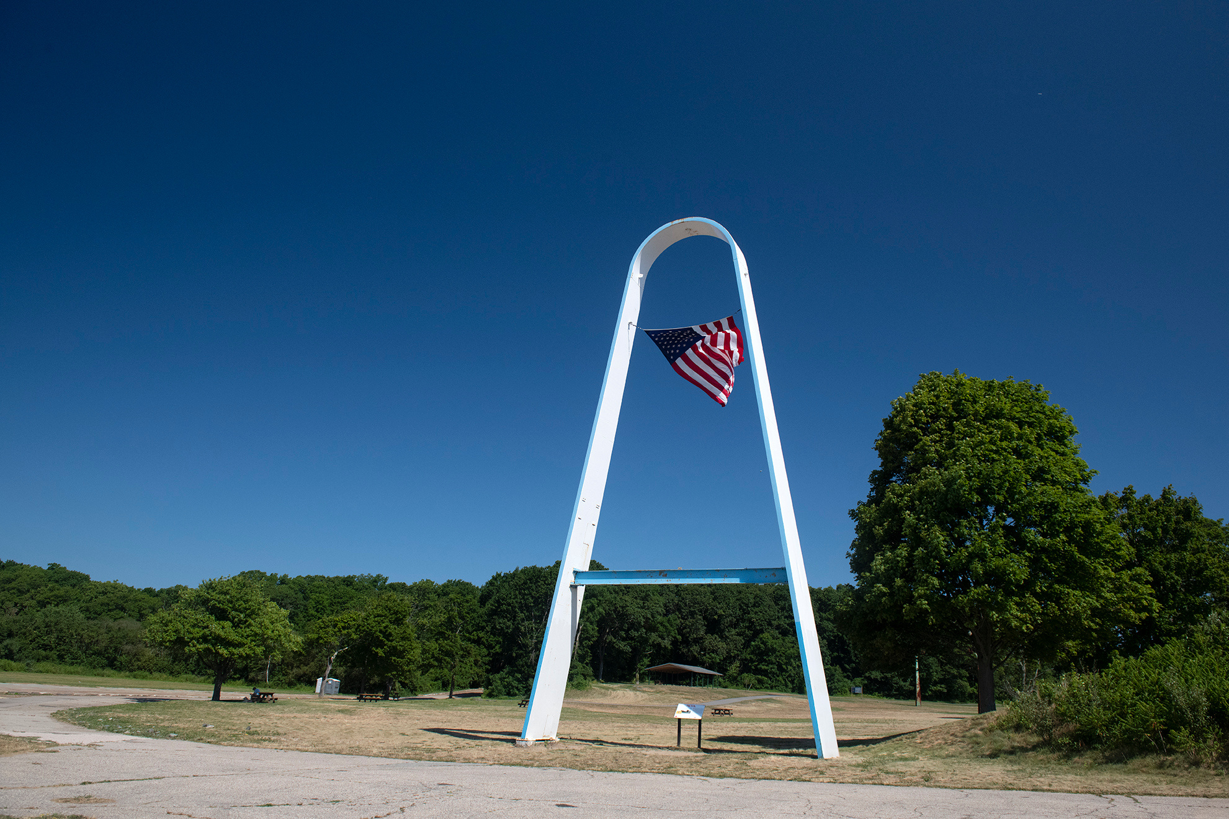
Future Steps
  CRMC, RISG, and NBNERR will invite staff of agencies (e.g., DEM), organizations (e.g., Save The Bay), and municipalities to help identify how to incorporate the recommendations into a plan.
  CRMC will fundraise for:
    Hiring a municipal liaison to aid cities and towns in working with CRMC and addressing municipal-level right-of-way issues (e.g., parking, maintenance).
    Other implementation activities (e.g., communications tools, signange, other needs identified by Community Leader Advisory Group)

Slide 17
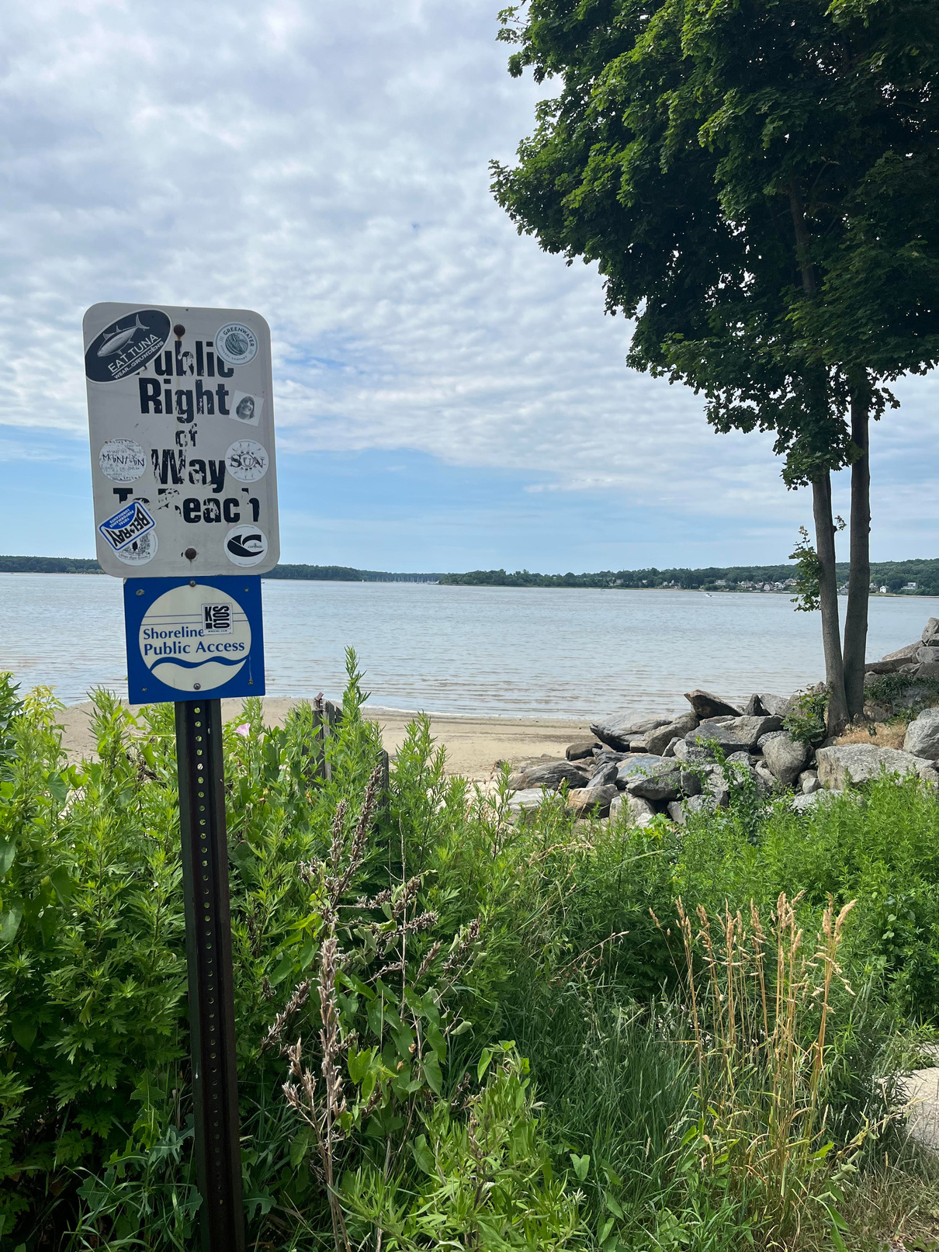
Resources
CRMC: Rights of Way & Public Access page
shoreline-ri.com

Slide 18
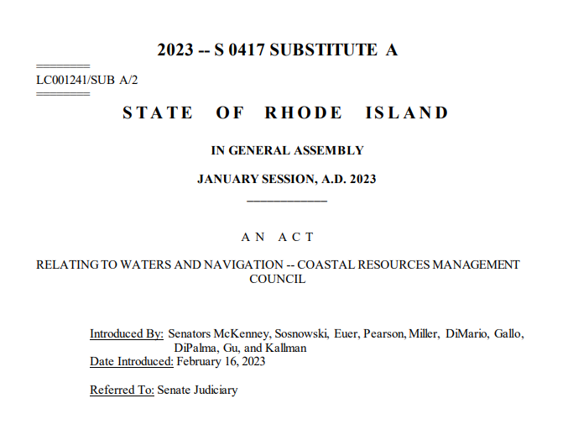
Shoreline Access Bill S-0417 Sub A – The Development & Implementation of the Expanded Shoreline Access Law

Slide 19

Overview of Presentation
Review of Shoreline Access Bill S-0147 & Pertinent Language
CRMC Programmatic Impacts
CRMC & Partners education & signage conceptual framework

Slide 20
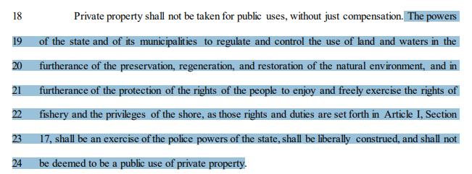

Slide 21
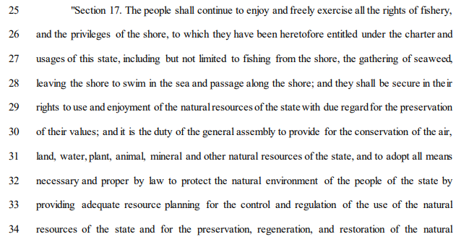

Slide 22
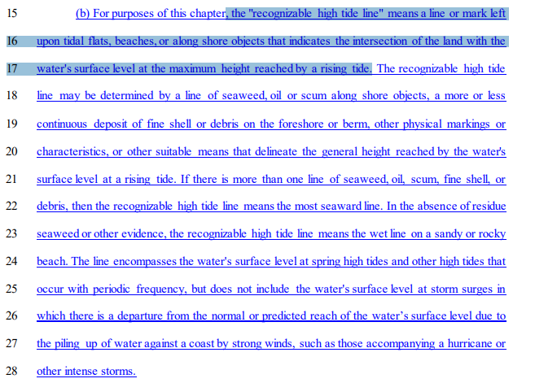

Slide 23
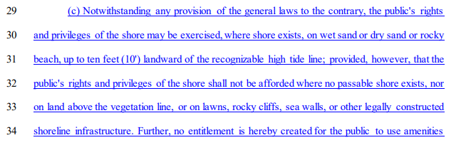

Notes:
Here is the part of the law describing where the new rules do NOT apply, and that is where no passable shore exists, nor on land above the vegetation line, or on lawns, rocky cliffs, sea walls or other legally constructed shoreline infrastructure. And, importantly, no entitlement created for the public to use privately owned amenities.

Slide 24
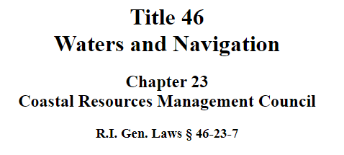
(3) Conservation officers within the department of environmental management, council staff, and state and municipal police shall have the authority to apply to a court of competent jurisdiction for a warrant to enter on private land to investigate possible violations of this chapter; provided, that they have reasonable grounds to believe that a violation has been committed, is being committed, or is about to be committed.

Slide 25
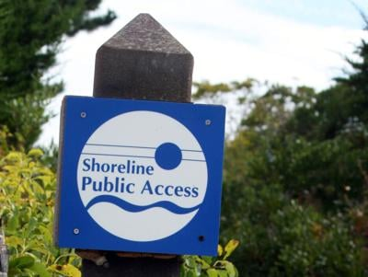
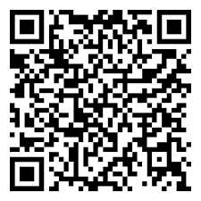
New QR Codes to be added to ROW Signs with Link-Tree
Click Below to Learn More About:
New Shoreline Access Bill S 0417 Sub A
CRMC Rights-of-Way Throughout the State
The Coastal Resources Management Council

Slide 26
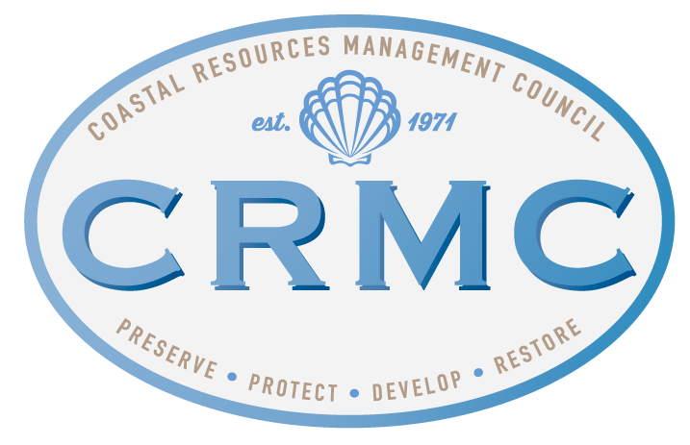
Thank you!
Coastal Resources Management Council
lfeldman@crmc.ri.gov
(401) 479-7404

